Slide 1


Data Processing/Analysis/Science with R
Al.I. Cuza University of Iași
Faculty of Economics and Business Administration
Department of Accounting, Information Systems and Statistics
Tree-Based Methods.
Classification and Regression Trees, Bagging, Random Forests, Boosting
By Marin Fotache

Slide 2
Agenda
Classification and Regression Trees
Basic idea
Terminology
Advantages and weaknesses
Regression Trees vs. Classification Trees
Criteria for doing the split (tree building)
Regression Trees: RSS
Classification Trees: Accuracy, Gini Index, Information Gain, Entropy
Build and visualize trees in R
Pruning the trees
Model performance
Conditional Inference Trees

Slide 3
Agenda (cont.)
Bagging
Basic idea
Implementation in R
Random Forests
Basic idea
Advantages and weaknesses
Implementations in R
Understanding random forests with `randomForestExplainer`
Boosting
Gradient Boosting
Extreme Gradient Boosting
Packages `gbm` and `xgboost` in R

Slide 4
Classification and Regression Trees (CART) – Video Tutorials
StatQuest: Decision Trees
https://www.youtube.com/watch?v=7VeUPuFGJHk
Decision Tree (Victor Lavrenko) – playlist:
https://www.youtube.com/playlist?list=PLBv09BD7ez_4temBw7vLA19p3tdQH6FYO
Decision Tree 1: how it works
ID3 algorithm: how it works
Decision Tree 3: which attribute to split on?
Decision Tree 4: Information Gain
Decision Tree 5: overfitting and pruning
Decision Tree 6: degenerate splits and gain ratio
Decision Tree 7: continuous, multi-class, regression
Decision Tree 8: Random Forests
Shannon Entropy and Information Gain
https://www.youtube.com/watch?v=9r7FIXEAGvs
Introduction to Entropy for Data Science
https://www.youtube.com/watch?v=IPkRVpXtbdY

Slide 5
Classification and Regression Trees (CART) – Video Tutorials (cont.)
entropyAndGain
https://www.youtube.com/watch?v=eLlYSpVjH94
Let’s Write a Decision Tree Classifier from Scratch - Machine Learning Recipes #8
https://www.youtube.com/watch?v=LDRbO9a6XPU&t=270s
Decision Tree Algorithm & Analysis | Machine Learning Algorithm | Data Science Training | Edureka
https://www.youtube.com/watch?v=opQ49Xr748k
DSO 530: Decision Trees in R (Classification)
https://www.youtube.com/watch?v=GOJN9SKl_OE&t=793s
R - Regression Trees – CART
https://www.youtube.com/watch?v=MoBw5PiW56k
R - Classification Trees (part 2 using rpart)
https://www.youtube.com/watch?v=XLNsl1Da5MA&t=881s

Slide 6
CART– Tutorials, Case Studies
Chapter 8: Tree-Based Methods (slides, playlist)
https://www.dataschool.io/15-hours-of-expert-machine-learning-videos/
Classification and Regression Trees (CART) with rpart and rpart.plot
https://rpubs.com/minma/cart_with_rpart
Classification & Regression Trees
http://www.di.fc.ul.pt/~jpn/r/tree/tree.html
Decision Trees in R: Classification and Regression Trees
http://www.michaeljgrogan.com/decision-trees-r-classification-regression-trees/
Classification and regression trees (Michael Friendly, 2015)
http://ddar.datavis.ca/pages/extra/titanic-tree-ex.pdf
Regression Trees
http://uc-r.github.io/regression_trees

Slide 7
CART – Tutorials, Case Studies (cont.)
Classification and Regression Tree Analysis
https://www.bu.edu/sph/files/2014/05/MorganCART.pdf
Decision Trees in R using rpart
https://gormanalysis.com/decision-trees-in-r-using-rpart/
Classification and Regression Trees (Cavan Reilly, 2017)
http://www.biostat.umn.edu/~cavanr/asfChap6.pdf
A Complete Tutorial on Tree Based Modeling from Scratch (in R & Python)
https://www.analyticsvidhya.com/blog/2016/04/complete-tutorial-tree-based-modeling-scratch-in-python/

Slide 8
Decision Trees
A type of supervised learning algorithm (having a pre-defined target variable)
Mostly used in classification problems (but can also be applied for regression problems)
Works for both categorical and continuous input and output variables.
Basic idea: split the population or sample into two or more homogeneous sets (or sub-populations) based on most significant splitter / differentiator in input variables

Slide 9
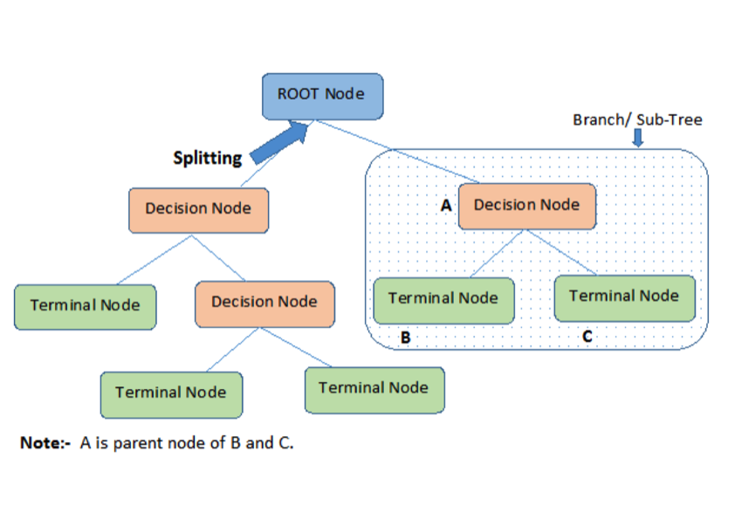
Decision Trees - Terminology
https://www.analyticsvidhya.com

Slide 10
Decision Trees – Terminology (cont.)
Root Node: Represents entire population or sample to be divided into two or more homogeneous sets.
Splitting: Process of dividing a node into two or more sub-nodes.
Decision Node: When a sub-node splits into further sub-nodes
Leaf/ Terminal Node: Nodes that do not split is called Leaf or Terminal node.
Pruning: Remove sub-nodes of a decision node. Opposite of splitting.
Branch / Sub-Tree: A sub section of entire tree
Parent and Child Node: A node which is divided into sub-nodes is called parent node of sub-nodes whereas the sub-nodes are the children of parent node.

Slide 11
Decision Trees – Advantages & Weaknesses
Main advantages
Easy to understand
Useful in data exploration: one of the fastest way to identify most significant variables and relation between two or more variables.
Less data cleaning required (compared to other techniques); it is not much influenced by outliers and missing values.
Data type is not a constraint (both numerical and categorical)
Non Parametric Method: (no assumptions about the space distribution and the classifier structure)
Main disadvantages
Overfitting (can be solved by setting constraints on model parameters and pruning)
Not fit for continuous variables: while working with continuous numerical variables, decision tree looses information when it categorizes variables in different categories.
https://www.analyticsvidhya.com

Slide 12
Classification vs. Regression Trees
Outcome variable:
Regression trees (RT) are used when the outcome is continuous.
Classification trees (CT) are used when the outcome is categorical.
Value obtained by terminal nodes:
RT: the mean response of observations falling in a certain region of the tree
CT: the mode (most common values) of observations falling in a certain region of the tree
Both CT and RT divide the predictor space (independent variables) into distinct and non-overlapping regions; one can think of these regions as high dimensional boxes or boxes
https://www.analyticsvidhya.com

Slide 13
Classification vs. Regression Trees (cont.)
Both CT and RT follow a top-down greedy approach known as recursive binary splitting.
‘top-down’ because it begins from the top of tree when all the observations are available in a single region and successively splits the predictor space into two new branches down the tree.
‘greedy’ because, the algorithm cares (looks for best variable available) about only the current split, and not about future splits which will lead to a better tree.
The splitting process is continued until a user defined stopping criteria is reached (e.g. the number of observations per node becomes less than 50)
For both CT and RT, the splitting process results in fully grown trees until the stopping criteria is reached.
The fully grown tree is likely to overfit data, leading to poor accuracy on unseen data; this requires ‘pruning’
https://www.analyticsvidhya.com

Slide 14
Criteria for doing the split (tree building)
For Regression Trees
Residual Sum of Squares
For Classification Trees
Classification Error Rate
Gini Index
Chi-Square
Information Gain (Entropy)
Reduction in Variance

Slide 15
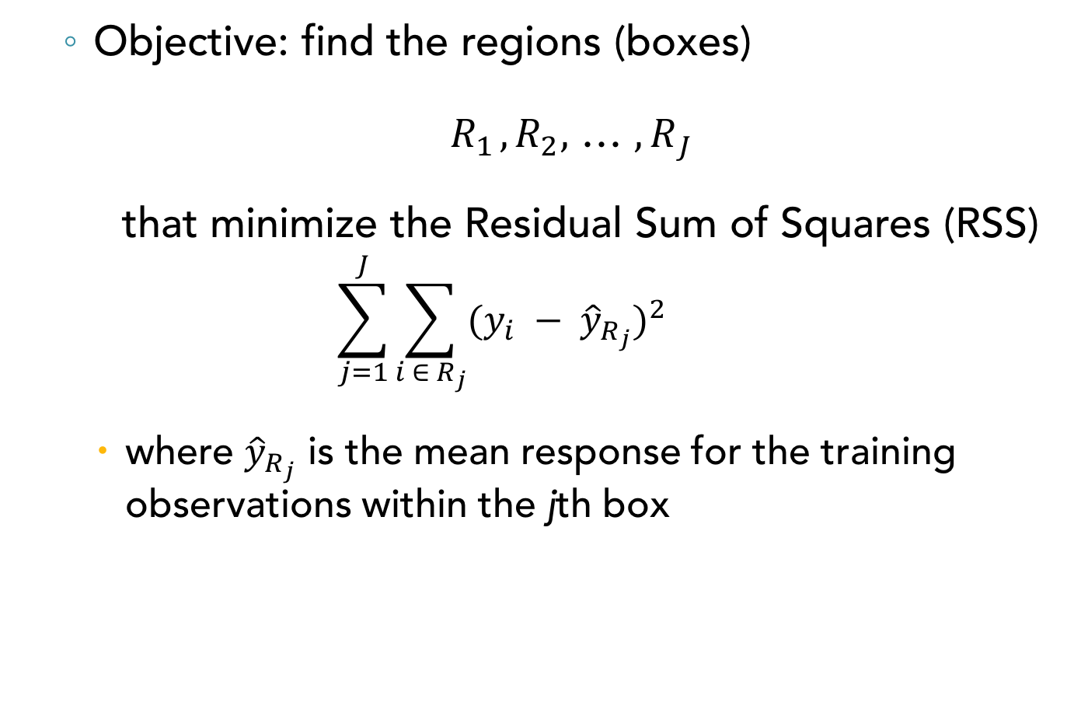
Regression Trees Building
Objective: find the regions (boxes)
$R_{1^{ }},R_{2},$ … ${, R}_{J^{ }}$
that minimize the Residual Sum of Squares (RSS)
$$\sum_{j=1}^{J}{\sum_{i ∈ R_{j}}^{ }{{(y_{i} − {\hat{y}}_{R_{j}})}^{2}} }$$
where ${\hat{y}}_{R_{j}}$ is the mean response for the training observations within the jth box
James et. al., 2014

Slide 16
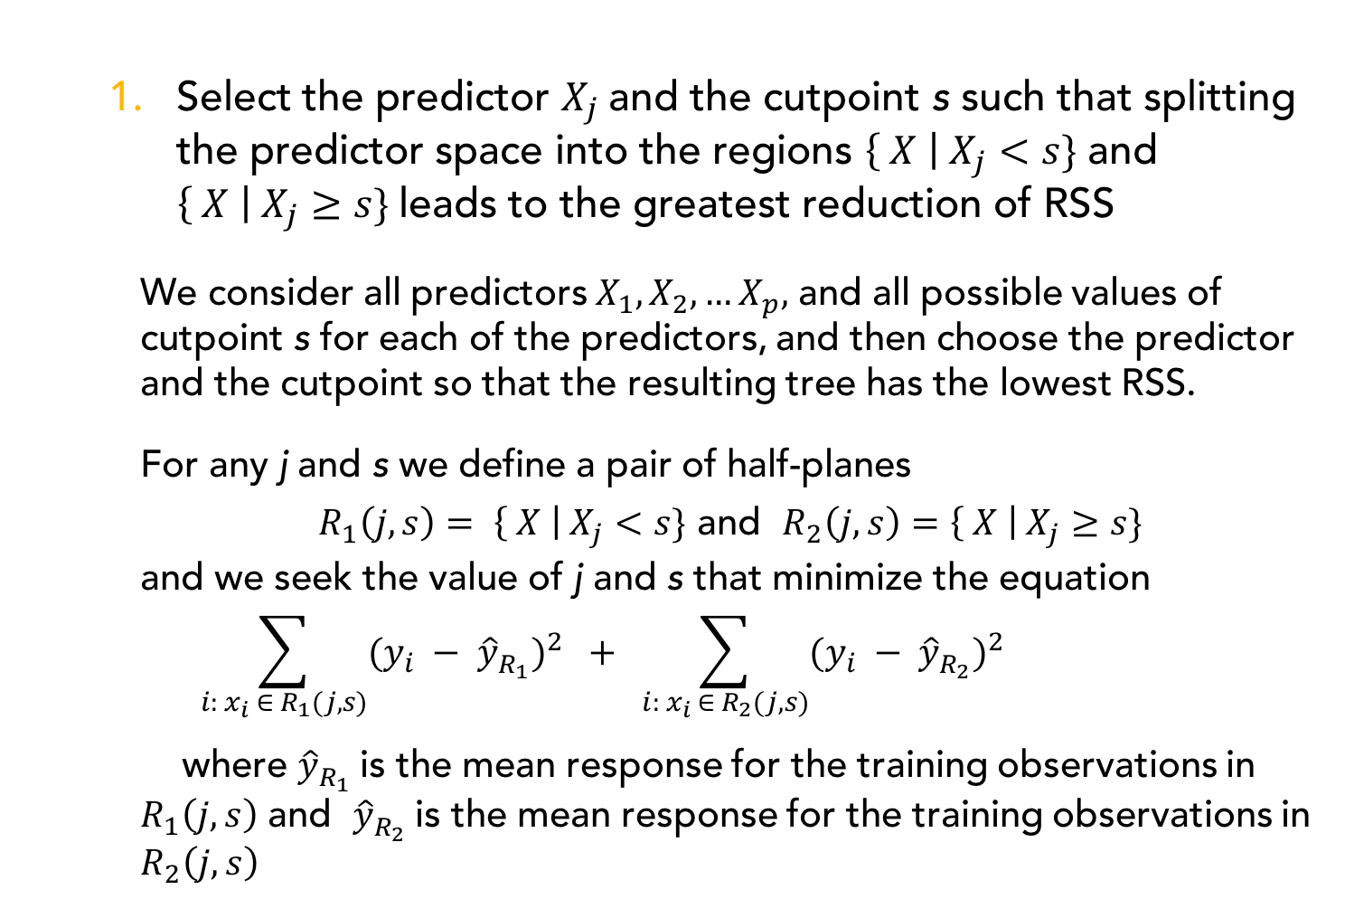
Recursive binary splitting for RT
Select the predictor $X_{j}$and the cutpoint s such that splitting the predictor space into the regions $\left\{ X \right| X_{j}<s\}$ and $\left\{ X \right| X_{j}≥s\}$leads to the greatest reduction of RSS
We consider all predictors $X_{1},X_{2}, …X_{p},$ and all possible values of cutpoint s for each of the predictors, and then choose the predictor and the cutpoint so that the resulting tree has the lowest RSS.
For any j and s we define a pair of half-planes
$R_{1}\left(j, s\right)= \left\{ X \right| X_{j}<s\}$ and $R_{2}\left(j, s\right)=\left\{ X \right| X_{j}≥s\}$
and we seek the value of j and s that minimize the equation
$$\sum_{i: x_{i} ∈ R_{1}(j, s)}{{(y_{i} − {\hat{y}}_{R_{1}}^{ })}^{2}} + \sum_{i: x_{i} ∈ R_{2}(j, s)}{{(y_{i} − {\hat{y}}_{R_{2}}^{ })}^{2}}$$
where ${\hat{y}}_{R_{1}}^{ }$is the mean response for the training observations in $R_{1}\left(j, s\right)$ and ${\hat{y}}_{R_{2}}^{ }$is the mean response for the training observations in $R_{2}\left(j, s\right)$
James et. al., 2014

Slide 17
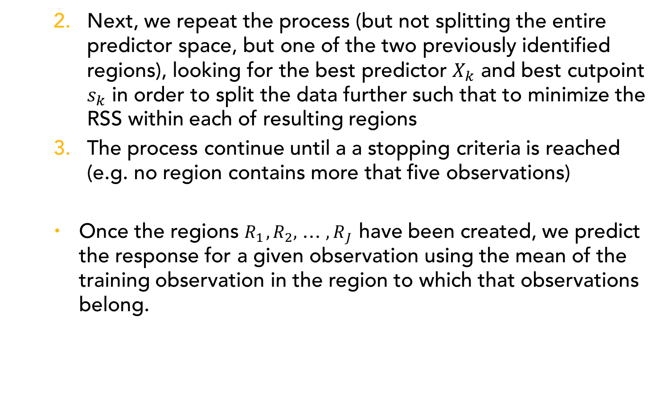
Recursive binary splitting for RT (cont.)
Next, we repeat the process (but not splitting the entire predictor space, but one of the two previously identified regions), looking for the best predictor $X_{k}$ and best cutpoint $s_{k}$ in order to split the data further such that to minimize the RSS within each of resulting regions
The process continue until a a stopping criteria is reached (e.g. no region contains more that five observations)
Once the regions $R_{1^{ }},R_{2},$ … ${, R}_{J^{ }}$have been created, we predict the response for a given observation using the mean of the training observation in the region to which that observations belong.
James et. al., 2014

Slide 18
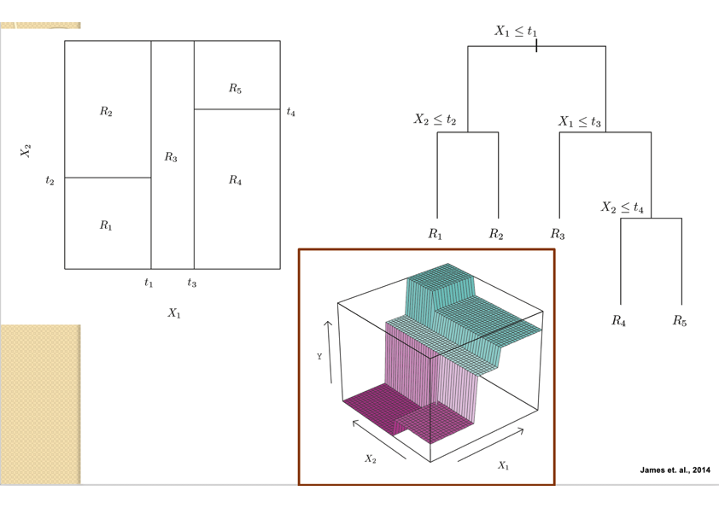
Example of Recursive binary splitting for RT

Slide 19
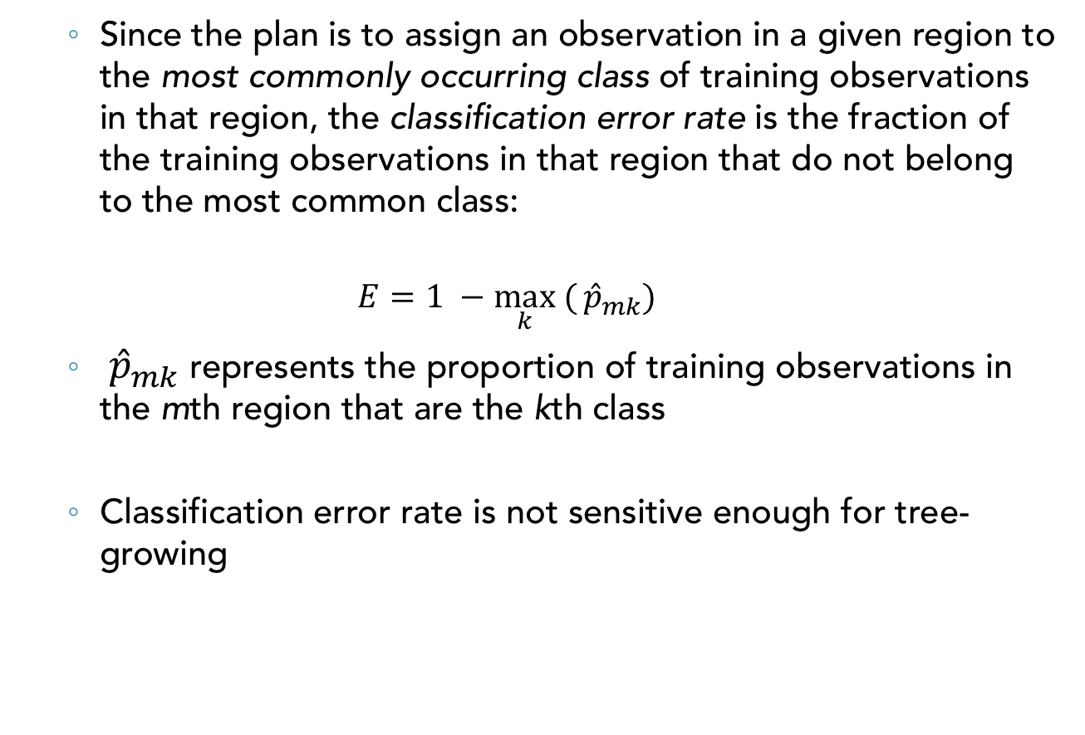
Classification Error Rate
Since the plan is to assign an observation in a given region to the most commonly occurring class of training observations in that region, the classification error rate is the fraction of the training observations in that region that do not belong to the most common class:
$$E=1 −\max_{k}{(}{\hat{p}}_{mk})$$
${\hat{p}}_{mk}$ represents the proportion of training observations in the mth region that are the kth class
Classification error rate is not sensitive enough for tree-growing
James et. al., 2014

Slide 20
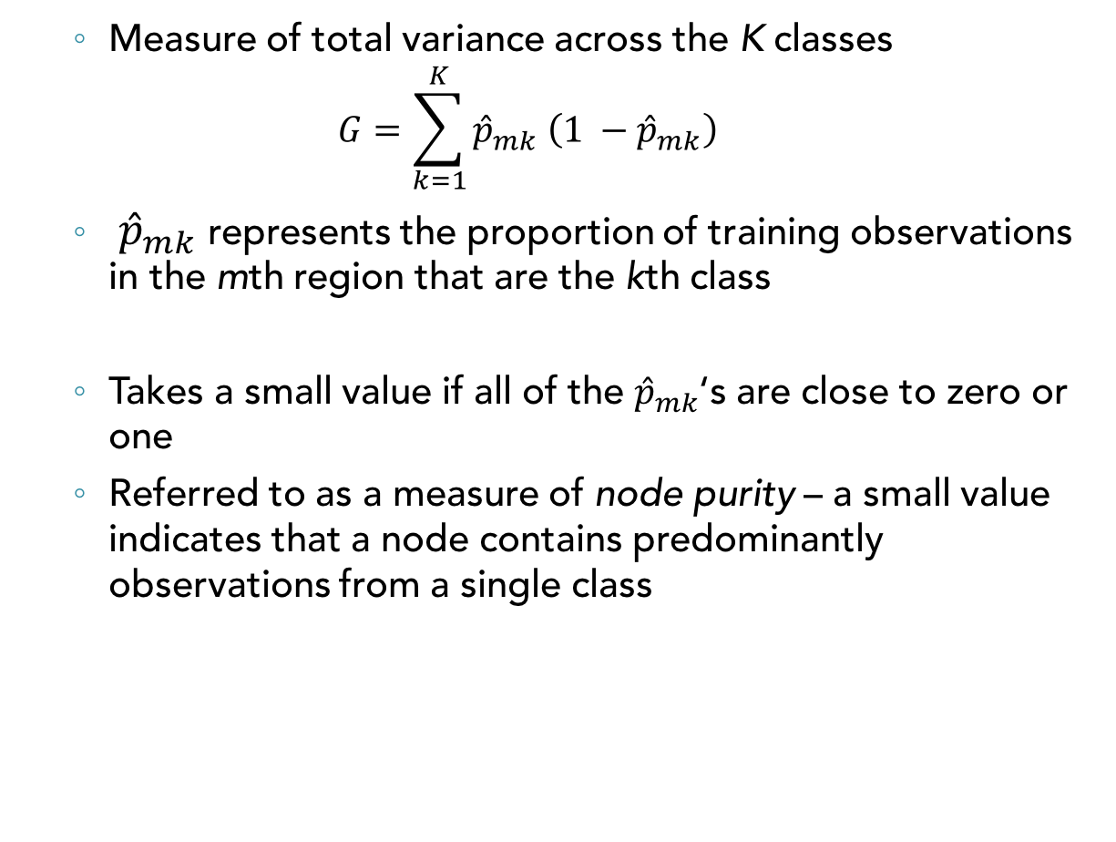
Gini Index
Measure of total variance across the K classes
$$G=\sum_{k=1}^{K}{{\hat{p}}_{mk} \left(1 −{\hat{p}}_{mk}\right)}$$
${\hat{p}}_{mk}$ represents the proportion of training observations in the mth region that are the kth class
Takes a small value if all of the ${\hat{p}}_{mk}$‘s are close to zero or one
Referred to as a measure of node purity – a small value indicates that a node contains predominantly observations from a single class
James et. al., 2014

Slide 21
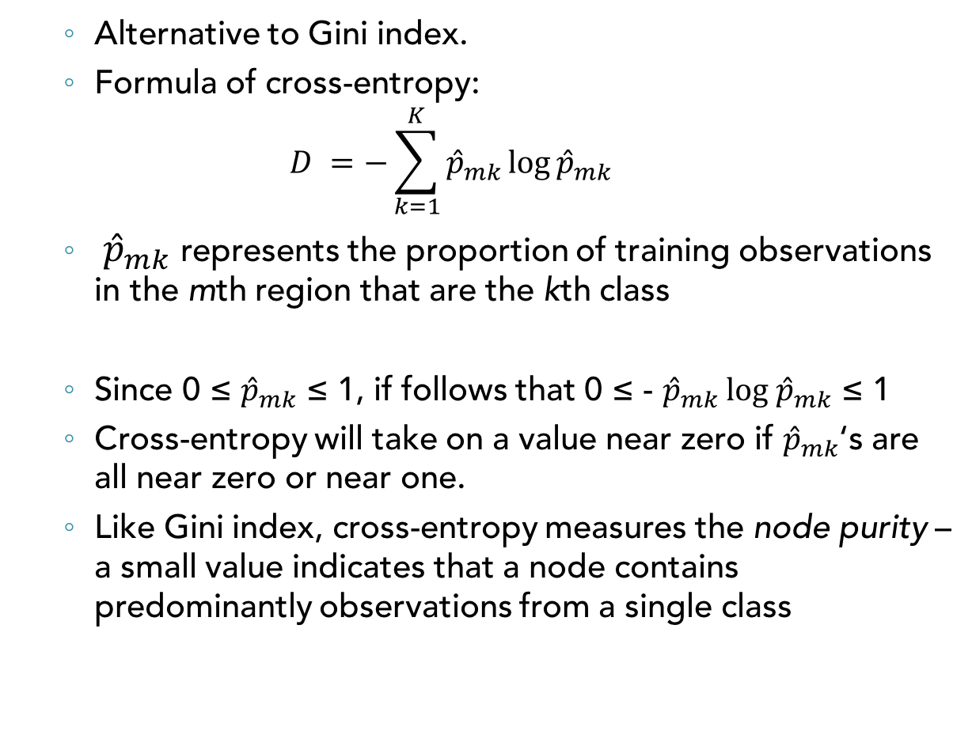
Cross-Entropy
Alternative to Gini index.
Formula of cross-entropy:
$$D =−\sum_{k=1}^{K}{{\hat{p}}_{mk}\log{{\hat{p}}_{mk}} }$$
${\hat{p}}_{mk}$ represents the proportion of training observations in the mth region that are the kth class
Since 0 ≤ ${\hat{p}}_{mk}$ ≤ 1, if follows that 0 ≤ - ${\hat{p}}_{mk}$ log ${\hat{p}}_{mk}$ ≤ 1
Cross-entropy will take on a value near zero if ${\hat{p}}_{mk}$‘s are all near zero or near one.
Like Gini index, cross-entropy measures the node purity – a small value indicates that a node contains predominantly observations from a single class
James et. al., 2014

Slide 22
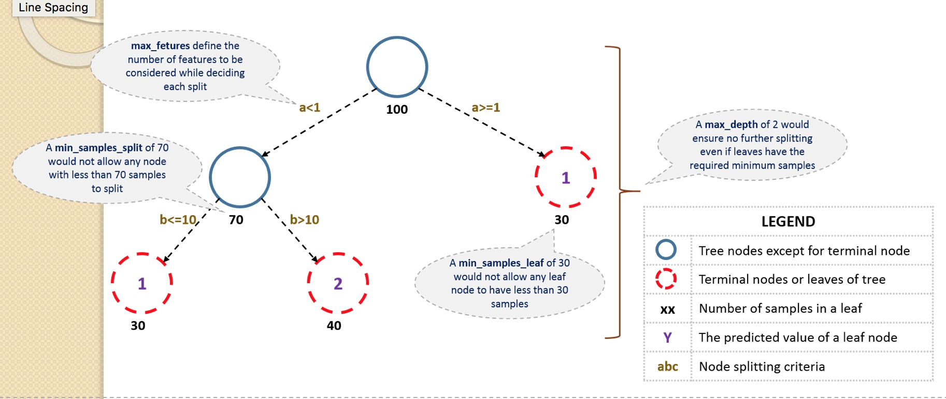
Tuning the Tree Size
https://www.analyticsvidhya.com

Slide 23
Tuning the Tree Size (cont.)
Minimum samples for a node split
defines the minimum number of samples (or observations) which are required in a node to be considered for splitting
used to control over-fitting: higher values prevent a model from learning relations which might be highly specific to the particular sample selected for a tree.
too high values can lead to under-fitting; hence, it should be tuned using CV.
Minimum samples for a terminal node (leaf)
defines the minimum samples (or observations) required in a terminal node or leaf.
used to control over-fitting similar to min_samples_split: generally, lower values should be chosen for imbalanced class problems because the regions in which the minority class will be in majority will be very small.
https://www.analyticsvidhya.com

Slide 24
Tuning the Tree Size (cont.)
Maximum depth of tree (vertical depth)
used to control over-fitting as higher depth will allow model to learn relations very specific to a particular sample.
should be tuned using CV.
Maximum number of terminal nodes
The maximum number of terminal nodes or leaves in a tree.
Can be defined in place of max_depth.
Since binary trees are created, a depth of ‘n’ would produce a maximum of 2^n leaves.
Maximum features to consider for split
The number of features to consider while searching for a best split; these will be randomly selected.
As a thumb-rule, square root of the total number of features works great but we should check up to 30-40% of the total number of features.
Higher values can lead to over-fitting but depends on case to case.
https://www.analyticsvidhya.com

Slide 25
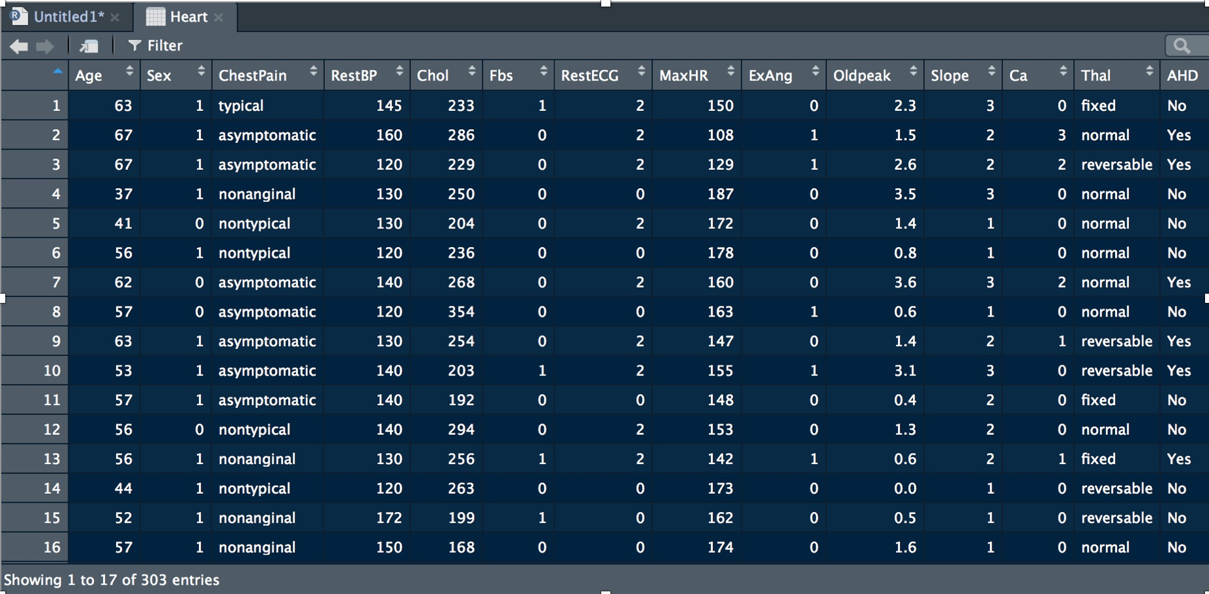
Example – Heart Data Set
303 observations, 13 predictors
Binary outcome: AHD (presence or absence of the heart disease)

Slide 26
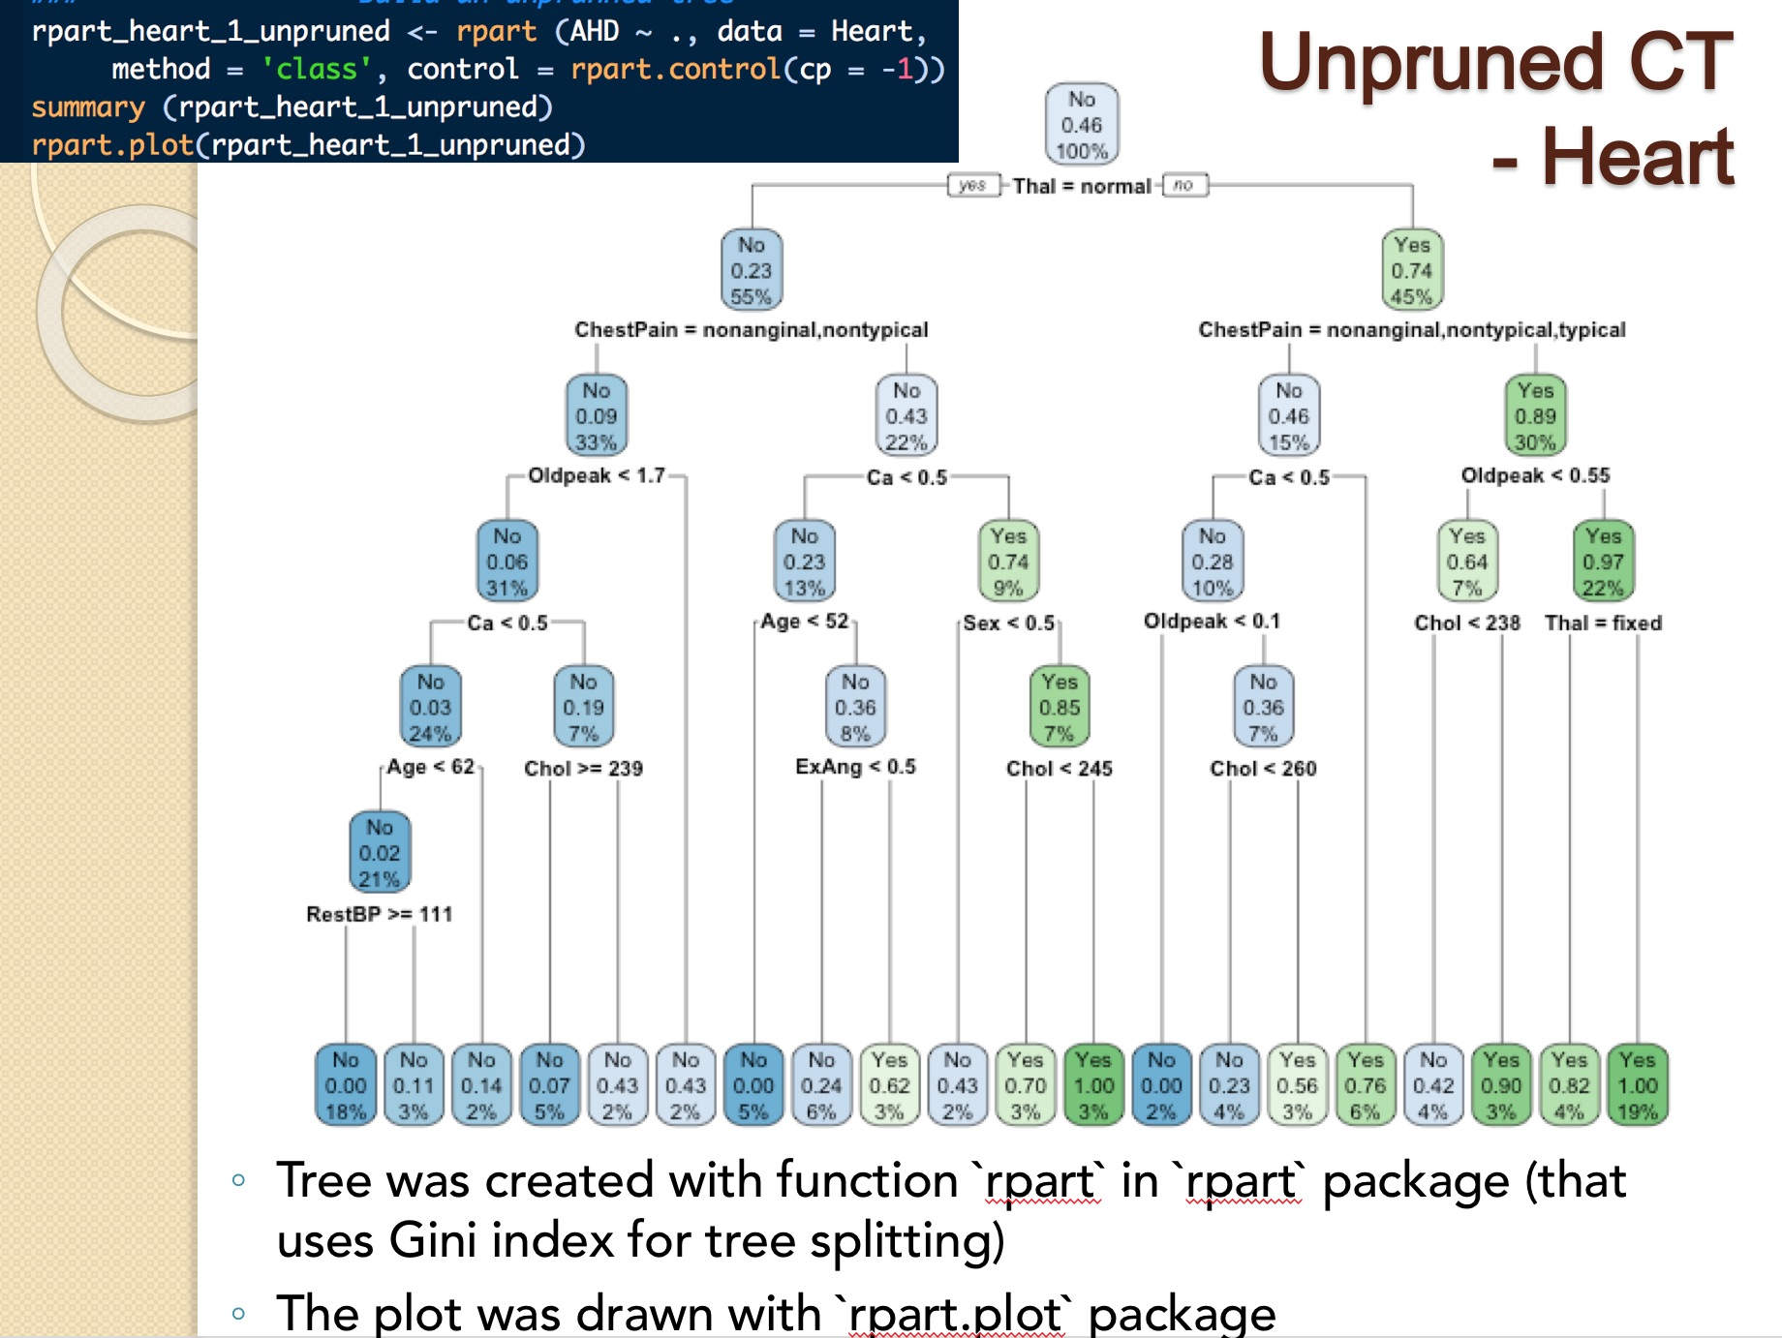
Ex. of Unpruned CT - Heart

Slide 27
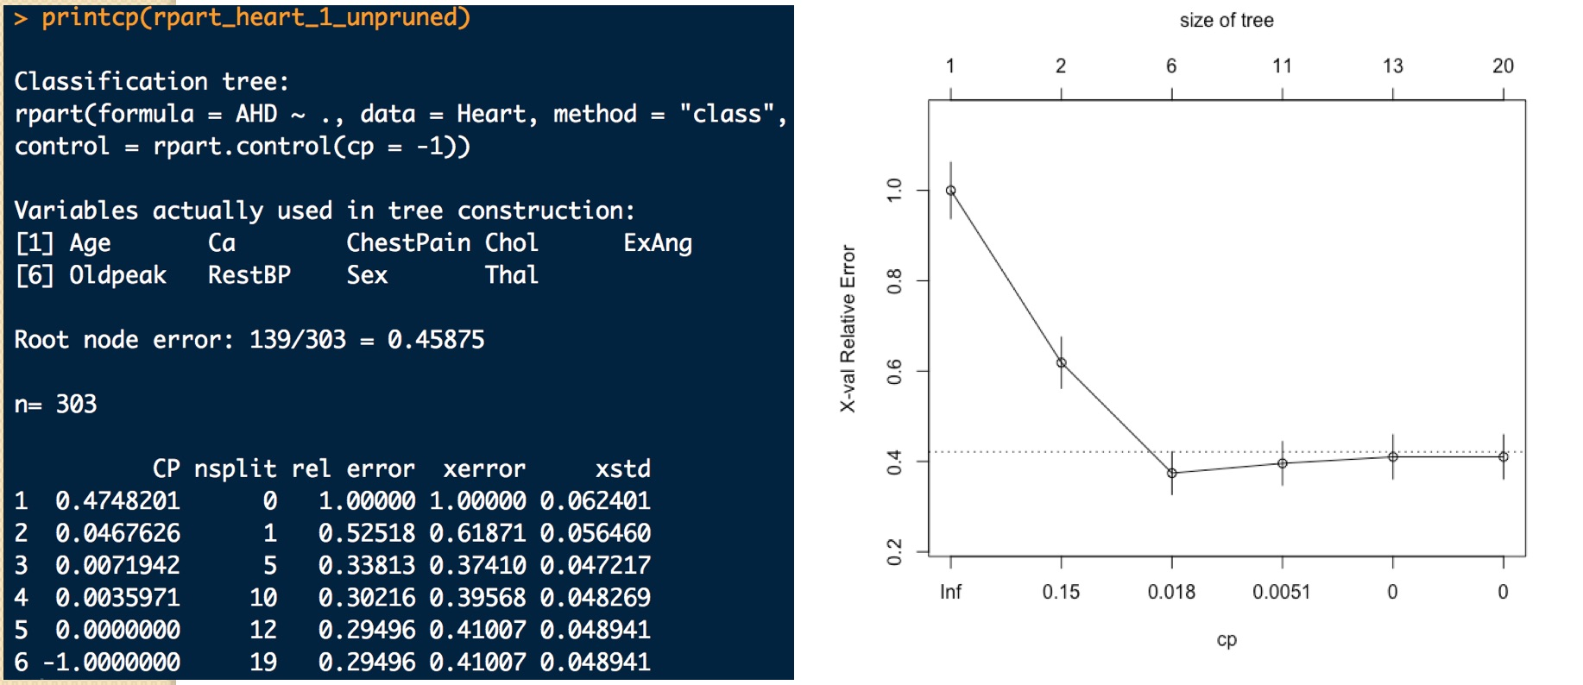
Unpruned CT – Heart – Cross-validation
When `rpart` grows a tree it performs 10-fold cross validation on the data.
The plot (right) was drawn with ` plotcp ` function
The lowest error was recorded for `cp` of 0.018

Slide 28
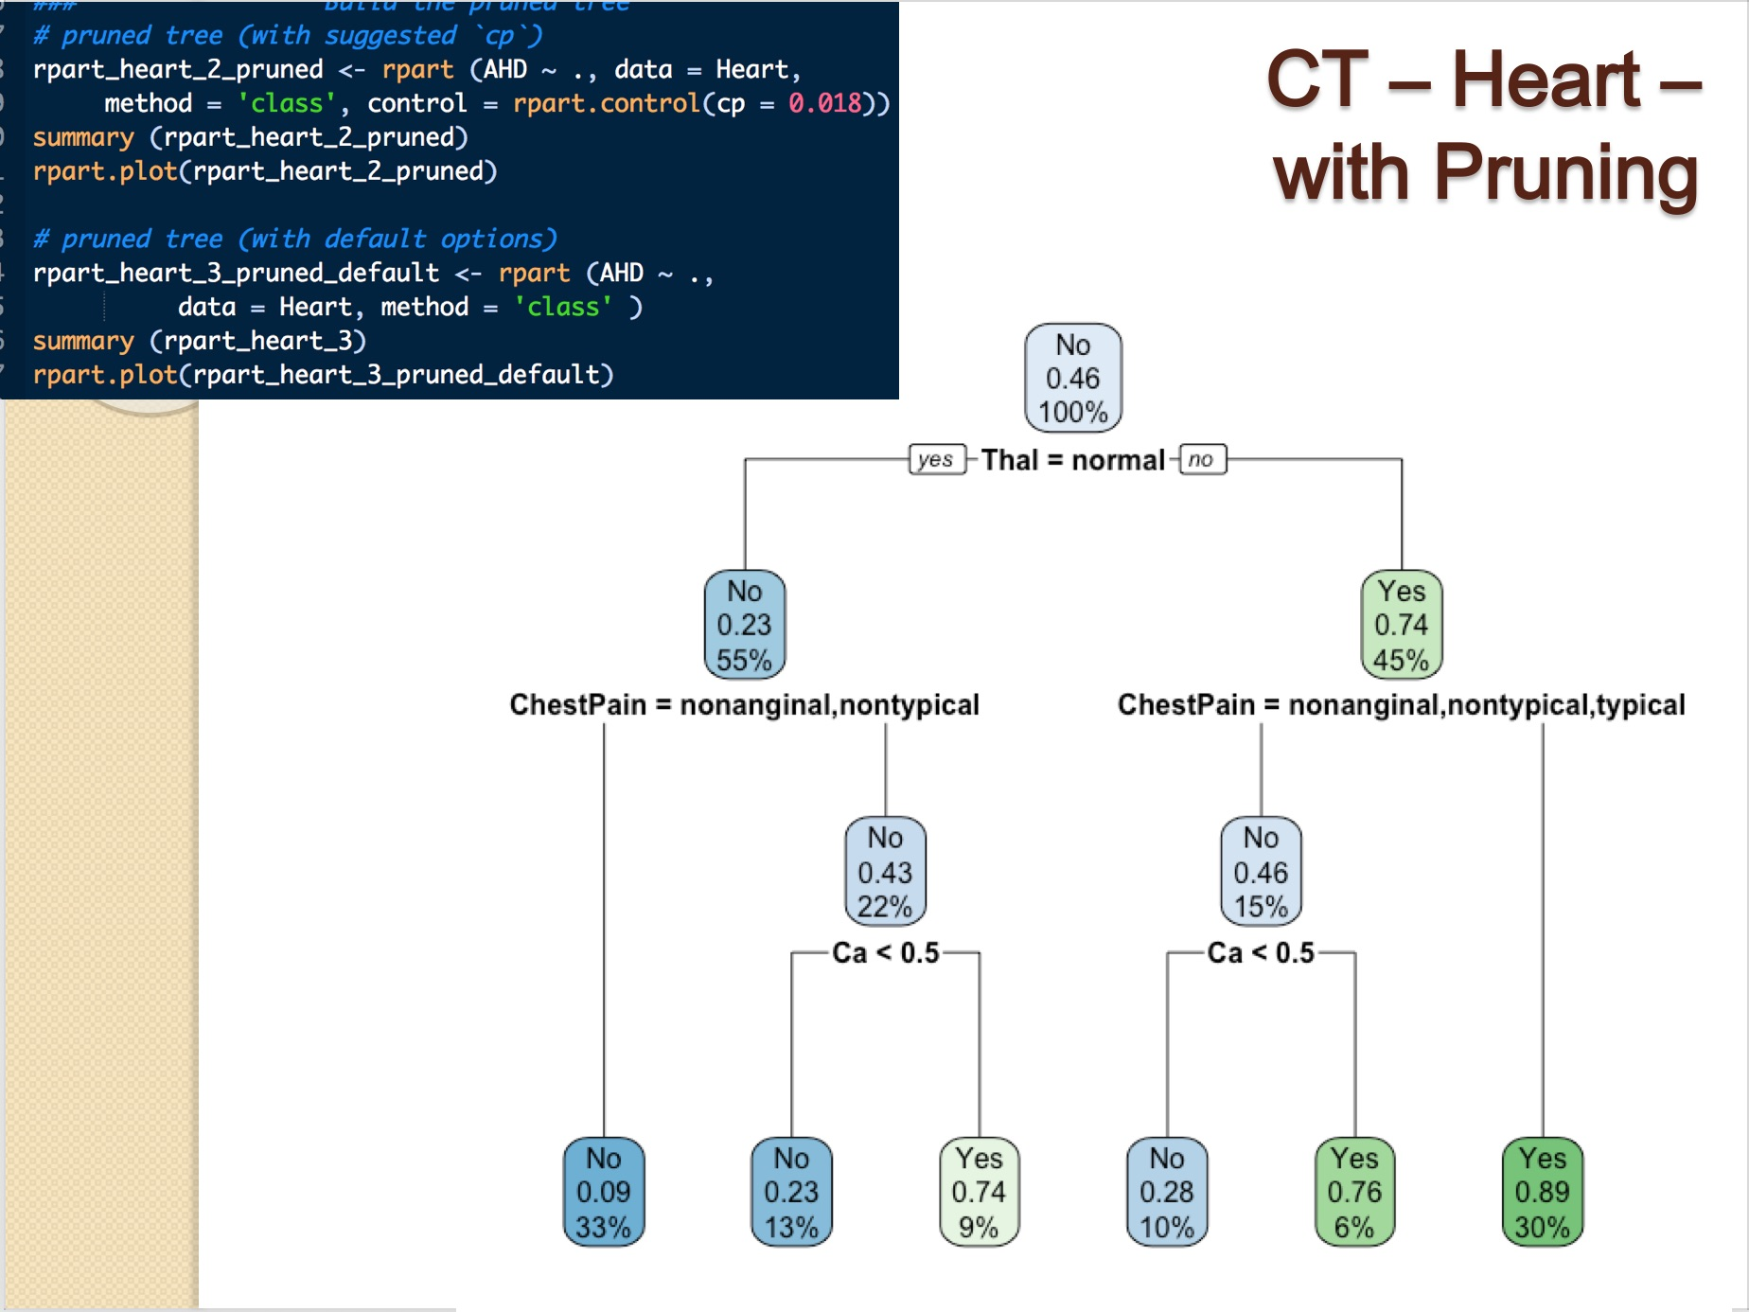
CT – Heart – with Pruning

Slide 29
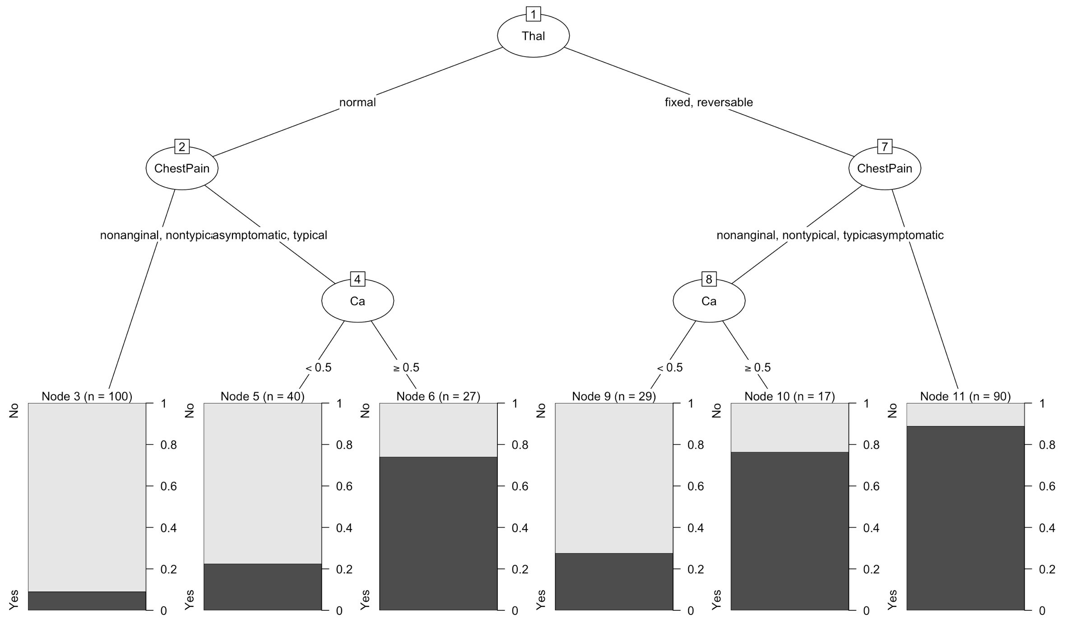
CT – Heart – Visualizing Pruned Tree Plot with `partykit` Package

Slide 30
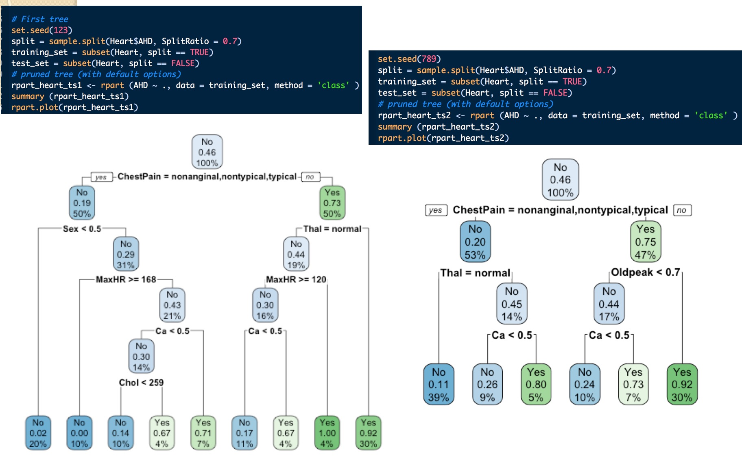
Revealing the CT High Variance

Slide 31
Bagging – Video Tutorials
Bootstrap aggregating bagging
https://www.youtube.com/watch?v=2Mg8QD0F1dQ
Ensembles (2): Bagging
https://www.youtube.com/watch?v=Rm6s6gmLTdg
Bagging & Boosting Algorithms | Decision Tree | Data Science (first part – Bagging)
https://www.youtube.com/watch?v=BXrrBWnuKlc
Predictive Modeling with Bagging Approach in R | R Programming
https://www.youtube.com/watch?v=g_RYT_Ip-zc

Slide 32
Bagging – Tutorials, Case Studies
Bagging Algorithm: Concepts with Example
http://dni-institute.in/blogs/bagging-algorithm-concepts-with-example/
Bagging / Bootstrap Aggregation with R (for linear regression)
http://amunategui.github.io/bagging-in-R/
Bagging & Boosting Algorithms | Decision Tree | Data Science
https://www.youtube.com/watch?v=BXrrBWnuKlc
Machine Learning Explained: Bagging
http://enhancedatascience.com/2017/06/28/machine-learning-explained-bagging/
Bagging and Random Forests (Rebecca C. Steorts)
http://www2.stat.duke.edu/~rcs46/lectures_2015/random-forest/randomforests.pdf

Slide 33
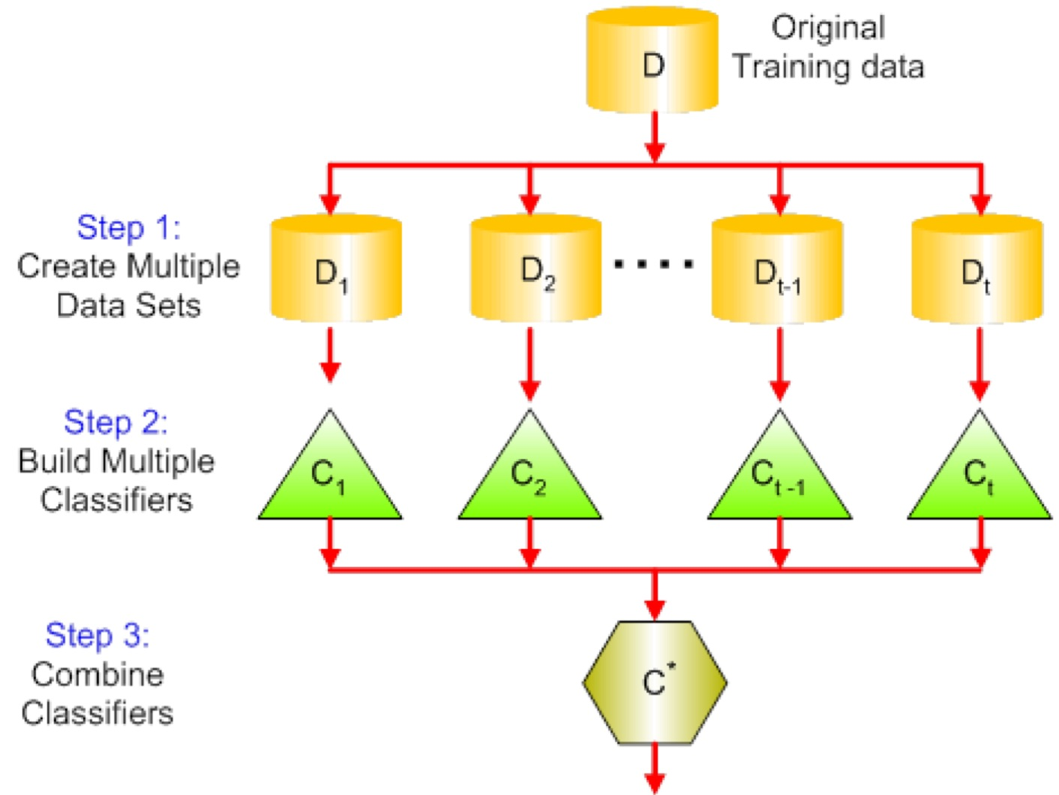
Bagging
Bagging is a technique used to reduce the variance of our predictions by combining the result of multiple classifiers modeled on different sub-samples of the same data set.
https://www.analyticsvidhya.com

Slide 34
Bagging (cont.)
Create multiple data sets:
Sampling is done with replacement on the original data and new datasets are formed.
The new data sets can have a fraction of the columns as well as rows, which are generally hyper-parameters in a bagging model
Taking row and column fractions less than 1 helps in making robust models, less prone to overfitting
Build multiple classifiers:
Classifiers are built on each data set.
Generally the same classifier is modeled on each data set and predictions are made.
Combine Classifiers:
The predictions of all the classifiers are combined using a mean, median or mode value depending on the problem at hand.
The combined values are generally more robust than a single model.
https://www.analyticsvidhya.com

Slide 35
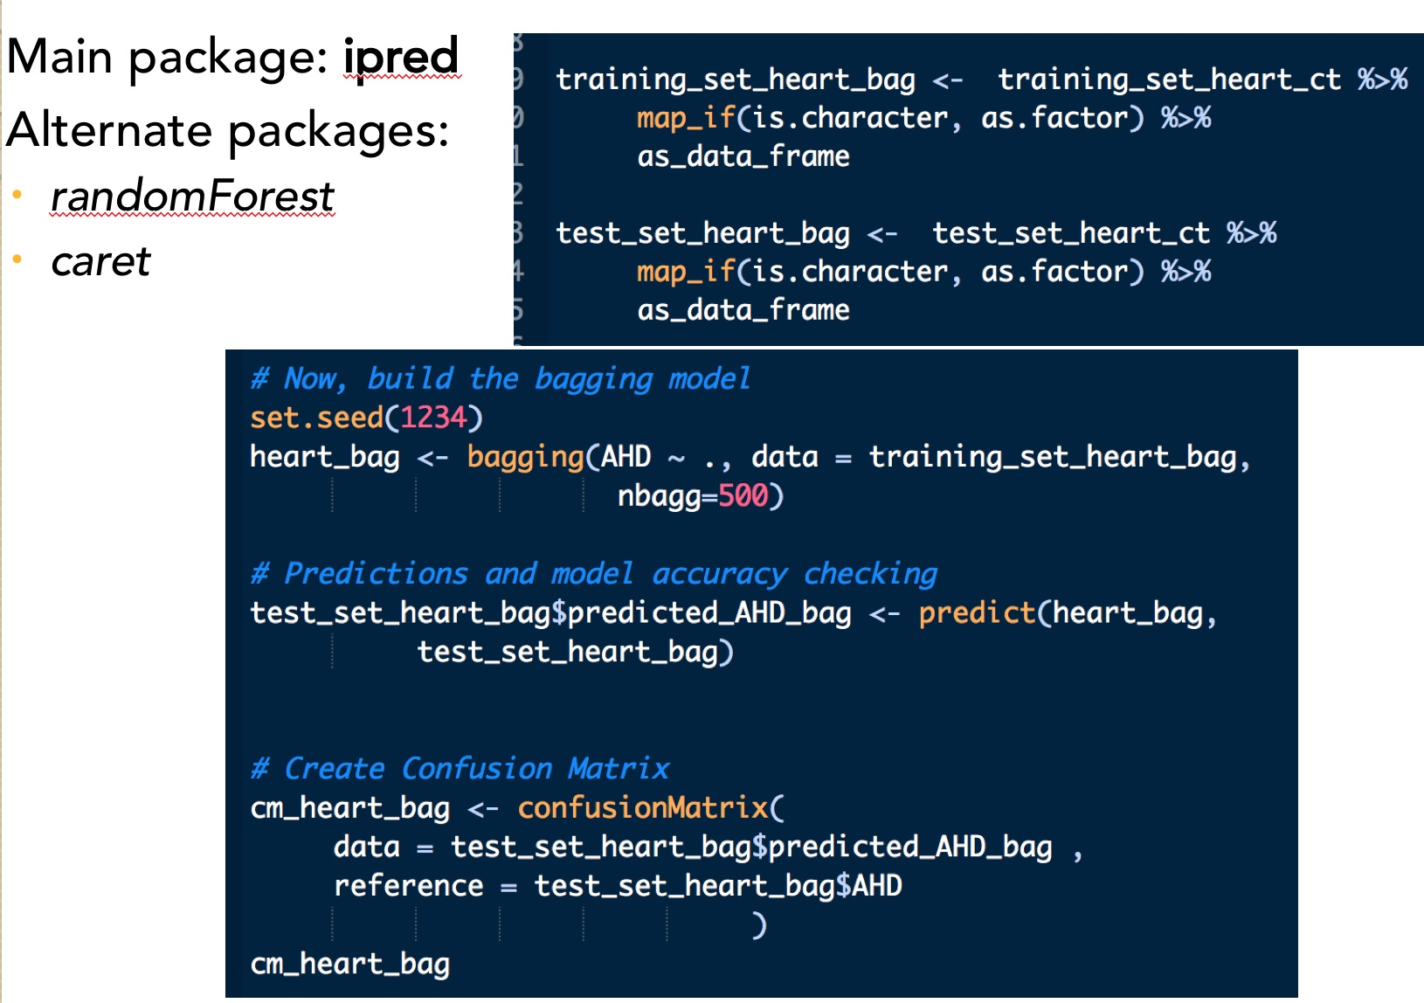
Bagging in R
Main package: ipred
Alternate packages:
randomForest
caret

Slide 36
Bagging vs. CT – Performance Metrics
Values for the Test Set | Classification Trees | Bagging
Accuracy | 0.69 95% CI: [0.61, 0.78] | 0.79 95% CI: [0.70, 0.86]
Kappa | 0.39 | 0.57
AUC | .799 | 0.879

Slide 37
Bagging vs. CT – ROC

Slide 38
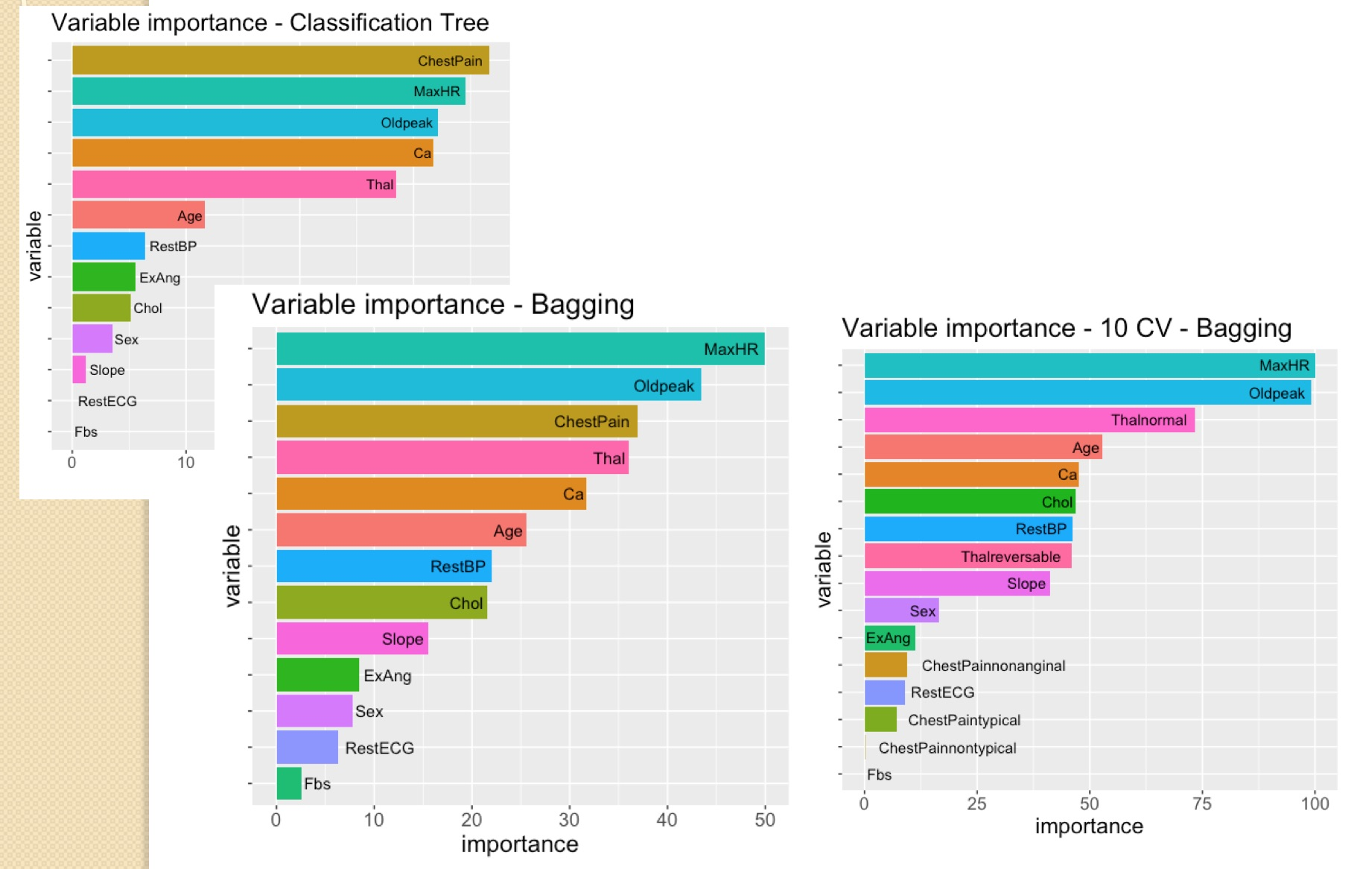
Variable Importance - Bagging vs. CT

Slide 39
Random Forests – Tutorials, Case Studies
How to implement Random Forests in R
https://r-posts.com/how-to-implement-random-forests-in-r/
Bagging and Random Forests (Rebecca C. Steorts)
http://www2.stat.duke.edu/~rcs46/lectures_2015/random-forest/randomforests.pdf
A very basic introduction to Random Forests using R
http://www.blopig.com/blog/2017/04/a-very-basic-introduction-to-random-forests-using-r/
RANDOM FOREST CLASSIFICATION OF MUSHROOMS
https://www.stoltzmaniac.com/random-forest-classification-of-mushrooms/
Bagging, Random Forests, Boosting
http://www.rmdk.ca/boosting_forests_bagging.html

Slide 40
Random Forests – Tutorials, Case Studies (cont.)
Random Forest Using R: Step by Step Tutorial
http://dni-institute.in/blogs/random-forest-using-r-step-by-step-tutorial/
Bagging and Random Forests
http://www2.stat.duke.edu/~rcs46/lectures_2015/random-forest/randomforests.pdf
Random Forests in R
https://datascienceplus.com/random-forests-in-r/

Slide 41
Random Forests – Video Tutorials
StatQuest: Random Forests Part 1 - Building, Using and Evaluating
https://www.youtube.com/watch?v=J4Wdy0Wc_xQ
Random Forest - Fun and Easy Machine Learning
https://www.youtube.com/watch?v=D_2LkhMJcfY&t=365s
Random Forests - The Math of Intelligence (Week 6)
https://www.youtube.com/watch?v=QHOazyP-YlM&t=156s
Data Science - Part V - Decision Trees & Random Forests
https://www.youtube.com/watch?v=OByOgGXq76A&t=2078s
Bootstrapping, Bagging and Random Forests
https://www.youtube.com/watch?v=3R0AW-vrPEw
Random Forest Model Theory & …
https://www.youtube.com/watch?v=KtCwOggGwgQ
Random Forest Tutorial …
https://www.youtube.com/watch?v=gmmV4drPTS4&t=3599s

Slide 42
Random Forests
Versatile machine learning method capable of performing both regression and classification tasks.
It also:
undertakes dimensional reduction methods,
treats missing values, outlier values and other essential steps of data exploration, and does a fairly good job.
Type of ensemble learning method, where a group of weak models combine to form a powerful model.
In Random Forest, multiple trees are grown as opposed to a single tree in CART model.
To classify a new object based on attributes, each tree gives a classification and we say the tree “votes” for that class. The forest chooses the classification having the most votes (over all the trees in the forest) and in case of regression, it takes the average of outputs by different trees.
https://www.analyticsvidhya.com

Slide 43
Random Forests Basic Algorithm
Assume number of cases in the training set is N. Then, sample of these N cases is taken at random but with replacement. This sample will be the training set for growing the tree.
If there are M input variables, a number m < M is specified such that at each node, m variables are selected at random out of the M. The best split on these m is used to split the node. The value of m is held constant while we grow the forest.
Similar to bagging, data is split randomly in many data sets; RF differs from bagging in using just a sample of a predictors (sqrt(M) for classification, M/3 for regression) when building each tree: this way the trees will be decorrelated
Each tree is grown to the largest extent possible and there is no pruning.
Predict new data by aggregating the predictions of the ntree trees (i.e., majority votes for classification, average for regression).
https://www.analyticsvidhya.com

Slide 44
Random Forests Advantages
Can be used for both classification and regression problems
Handles large data set with higher dimensionality; identifies the most significant variables (dimensionality reduction methods); further, the model outputs Importance of variable
Deals satisfactory with (large proportion of) missing data
Balances errors in data sets where classes are imbalanced.
Can be successful for unsupervised clustering, data views and outlier detection.
RF uses bootstrap sampling (1/3 of the data is not used for training and can be used to testing) - out of bag samples; error estimated on these out of bag samples is known as out of bag error; out-of-bag estimate is as accurate as using a test set of the same size as the training set. Therefore, using the out-of-bag error estimate removes the need for a set aside the test set.
https://www.analyticsvidhya.com

Slide 45
Random Forests Disadvantages
RF does a good job at classification but not as good as for regression problem as it does not give precise continuous nature predictions.
In case of regression, it doesn’t predict beyond the range in the training data, and that they may over-fit data sets that are particularly noisy.
RF is seen like a black box approach for statistical modelers – you have very little control on what the model does. You can at best – try different parameters and random seeds!
https://www.analyticsvidhya.com

Slide 46
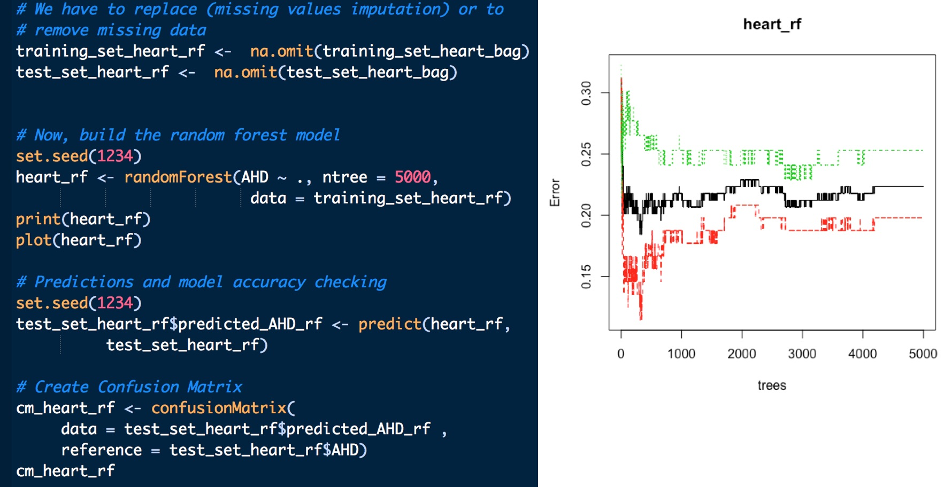
Random Forests in R
Main package: randomForest
Alternate packages: ranger (much faster)

Slide 47
Performance - Random Forests vs. Bagging
Values for the Test Set | Bagging | Random Forests
Accuracy | 0.79 95% CI: [0.70, 0.86] | 0.80 95% CI: [0.71, 0.87)]
Kappa | 0.57 | 0.59
AUC | 0.879 | 0.907

Slide 48
ROC Comparison – RF vs Bagging vs CT

Slide 49
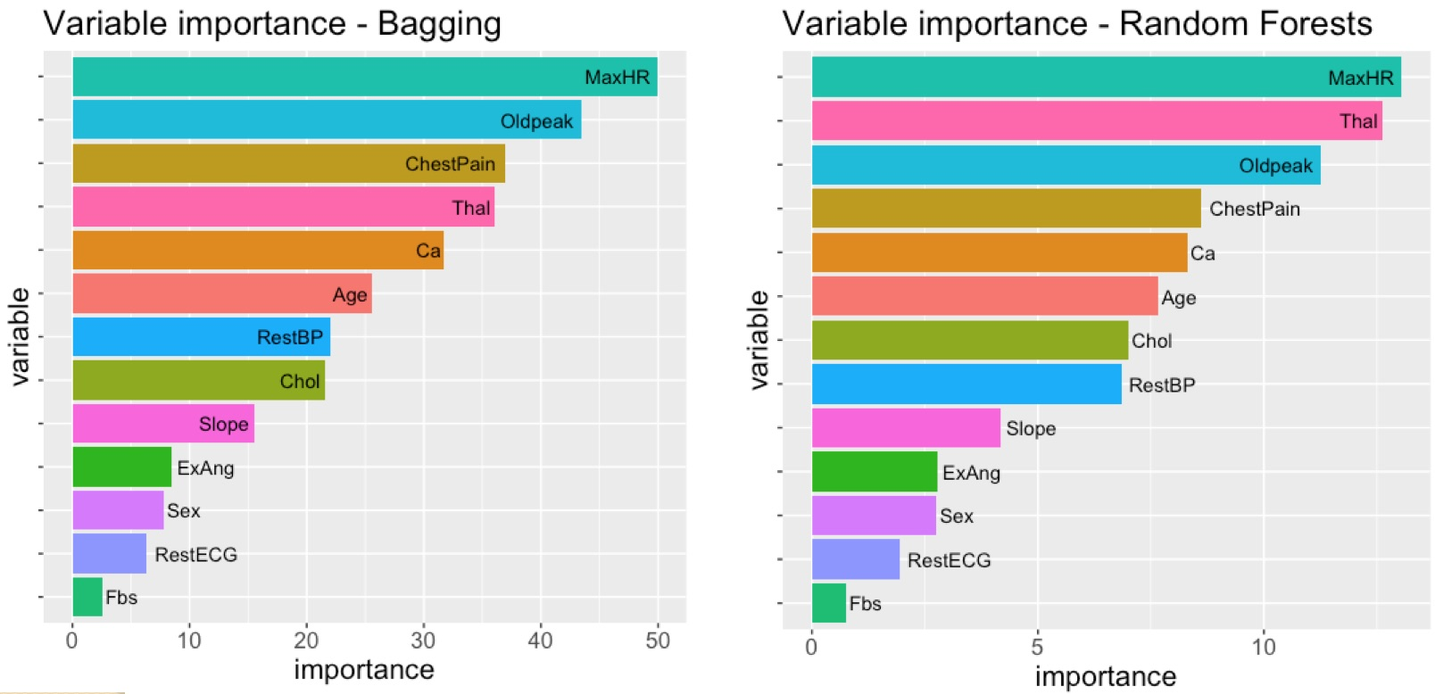
Random Forests vs. Bagging– Heart Data Set

Slide 50
Analyzing Random Forests with Package `randomForestExplainer`
Link:
https://rawgit.com/MI2DataLab/randomForestExplainer/master/inst/doc/randomForestExplainer.html
Main features:
Distribution of minimal depth
Various variable importance measures
Multi-way importance plot
Compare measures using ggpairs
Compare different rankings
Variable interactions
Explain the forest

Slide 51
Boosting – Tutorials, Case Studies
Bagging, Random Forests, Boosting
http://www.rmdk.ca/boosting_forests_bagging.html
How to build Ensemble Models in machine learning? (with R code)
https://www.analyticsvidhya.com/blog/2017/02/introduction-to-ensembling-along-with-implementation-in-r/
Gradient Boosting With Random Forest Classification in R
https://educationalresearchtechniques.com/2017/05/29/gradient-boosting-with-random-forest-classification-in-r/
Gradient boosting in R
https://datascienceplus.com/gradient-boosting-in-r/
Gradient Boosting Machine (GBM) Tutorial
http://allstate-university-hackathons.github.io/PredictionChallenge2016/GBM
Gradient Boosting Machines
https://github.com/ledell/useR-machine-learning-tutorial/blob/master/gradient-boosting-machines.Rmd

Slide 52
Boosting – Tutorials, Case Studies (cont.)
Understand your dataset with XGBoost
https://cran.r-project.org/web/packages/xgboost/vignettes/discoverYourData.html
XGBoost R Tutorial
http://xgboost.readthedocs.io/en/latest/R-package/xgboostPresentation.html
Extreme Gradient Boosting in R
https://rpubs.com/hariteja/xgb
Beginners Tutorial on XGBoost and Parameter Tuning in R
https://www.hackerearth.com/practice/machine-learning/machine-learning-algorithms/beginners-tutorial-on-xgboost-parameter-tuning-r/tutorial/

Slide 53
Boosting – Video Tutorials
Trevor Hastie - Gradient Boosting Machine Learning
https://www.youtube.com/watch?v=wPqtzj5VZus
Gradient Boosting Method and Random Forest - Mark Landry
https://www.youtube.com/watch?v=9wn1f-30_ZY
GBM
https://www.youtube.com/watch?v=WZvPUGNJg18
274 XGBoost in R
https://www.youtube.com/watch?v=zPrHUJXgXT4
Comparison of Random Forest and Extreme Gradient Boosting Project
https://www.youtube.com/watch?v=4cH8PzA3ov0
eXtreme Gradient Boosting XGBoost Algorithm with R - Example in Easy Steps with One-Hot Encoding
https://www.youtube.com/watch?v=woVTNwRrFHE&t=5s

Slide 54
Boosting
Boosting is a sequential technique in which
the first algorithm is trained on the entire dataset and
the subsequent algorithms are built by fitting the residuals of the first algorithm, thus giving higher weight to those observations that were poorly predicted by the previous model.
It relies on creating a series of weak learners each of which might not be good for the entire dataset but is good for some part of the dataset (each model actually boosts the performance of the ensemble).
Boosting is focused on reducing the bias and it is prone to overfitting (parameter tuning can reduse overfiting)
Types of boosting:
GBM
XGBoost
ADABOOST
https://www.analyticsvidhya.com

Slide 55
Boosting Basic Algorithm
Step 1: The base learner takes all the distributions and assign equal weight or attention to each observation.
Step 2: If there is any prediction error caused by first base learning algorithm, then we pay higher attention to observations having prediction error. Then, we apply the next base learning algorithm.
Step 3: Iterate Step 2 till the limit of base learning algorithm is reached or higher accuracy is achieved.
Finally, it combines the outputs from weak learner and creates a strong learner which eventually improves the prediction power of the model.
Boosting pays higher focus on examples which are mis-classiﬁed or have higher errors by preceding weak rules.
https://www.analyticsvidhya.com

Slide 56
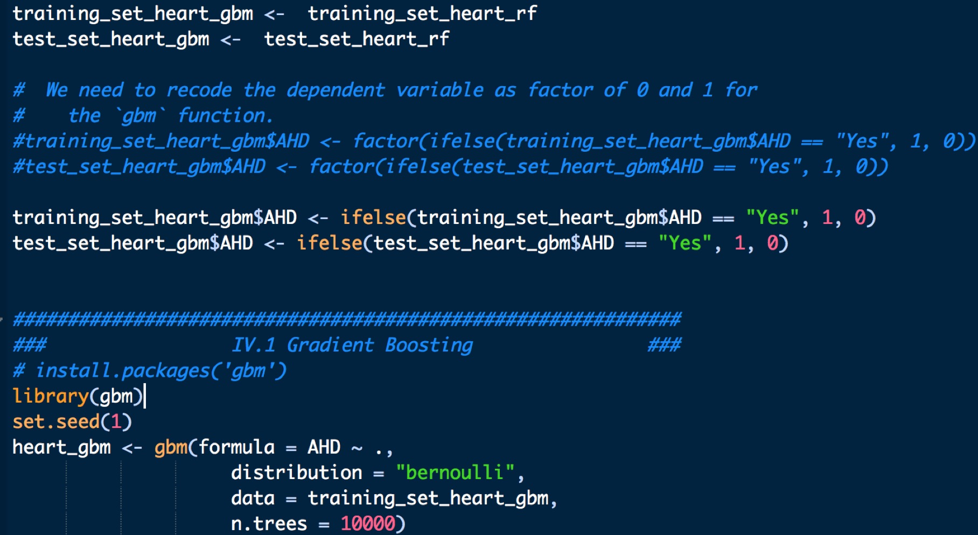
Gradient Boosting in R
Main package: gbm

Slide 57
Performance - GBM vs. Random Forests
Values for the Test Set | Random Forests | GBM
Accuracy | 0.80 95% CI: [0.71, 0.87)] | 0.86 95% CI: [0.78, 0.91)
Kappa | 0.59 | 0.71
AUC | 0.895 | 0.907

Slide 58
ROC Comparison – GBM vs RF vs Bagging vs CT

Slide 59
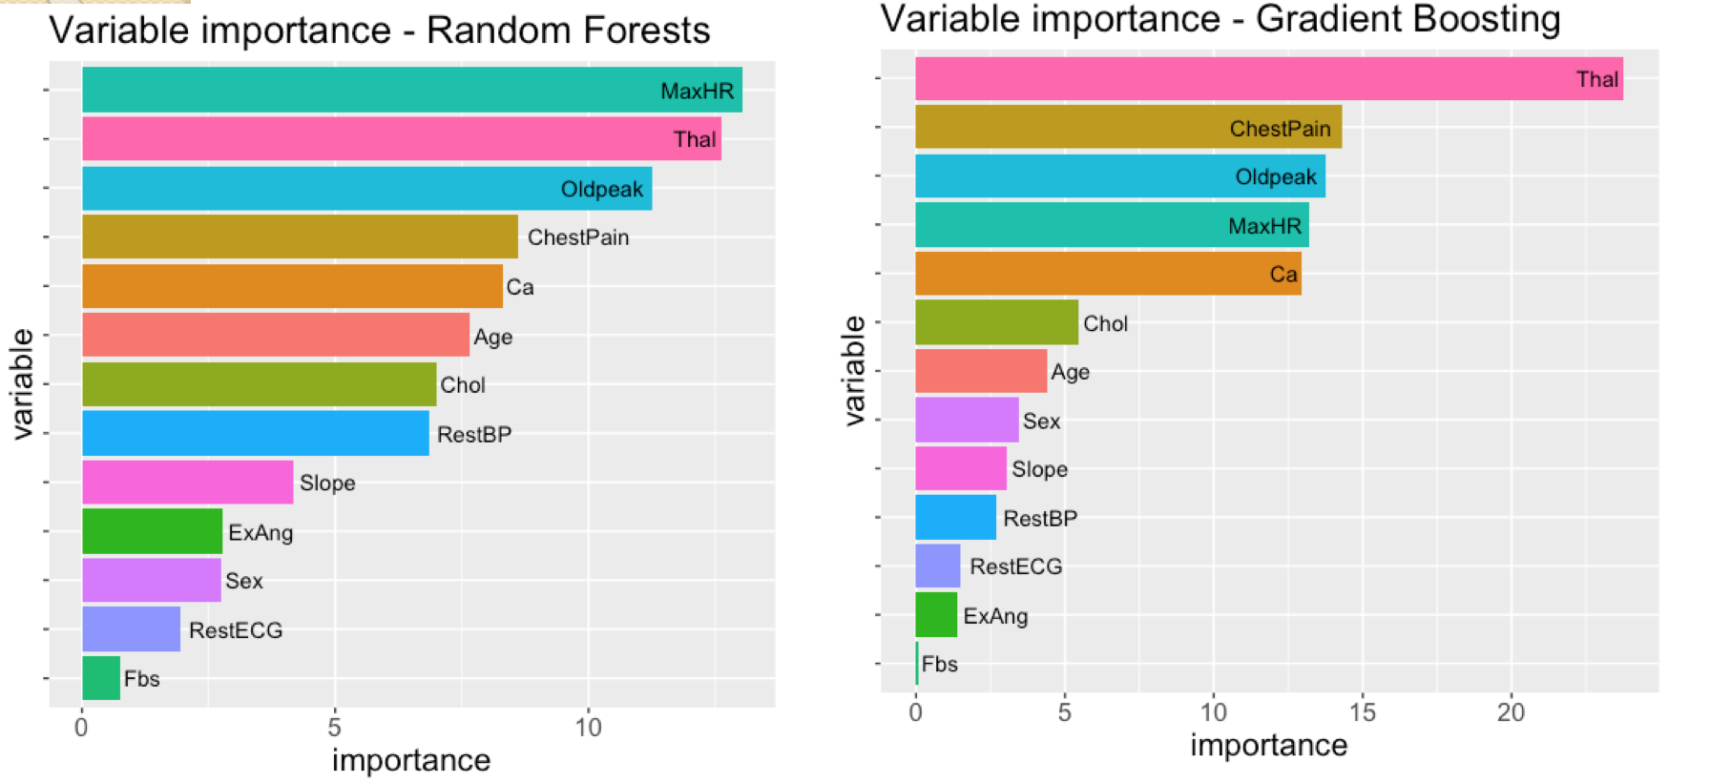
Random Forests vs. Bagging– Heart Data Set

